Slide 1


Slide 2
GROUND RULES
  Work together to
  stay on track
  Make your point
  and move on
  Debate IDEAS,
  not PEOPLE
  Ask questions if you have questions
  Be engaged and acknowledge each others’ contributions
  Share new ideas
  and be innovative!

Slide 3

FACILITIES
Restrooms require a key. Ladies turn left immediately and bathroom on the right. Mens are through the elevator bank and down hall to the left.
Coffee, Water, and Light Snacks available in the back of the room
Please turn Cell phones to silent and take call outside the meeting room
WiFi is available from the Guest network. Enter the password, then open a new Internet Explorer window and accept the terms.
GTRI spaces are secured. If you leave the area, knock on the glass doors to get back in
If you have any problems, call Katherine Escobar
757-434-3291

Slide 4
Welcome
Stakeholder Introductions
Please share:
Your name
Agency/affiliation
NIEM relationship/areas of involvement
(e.g., Domain, NBAC, NTAC, ESC, NMO, Emerging Technology Tiger Team, International Tiger Team, etc.)

Slide 5
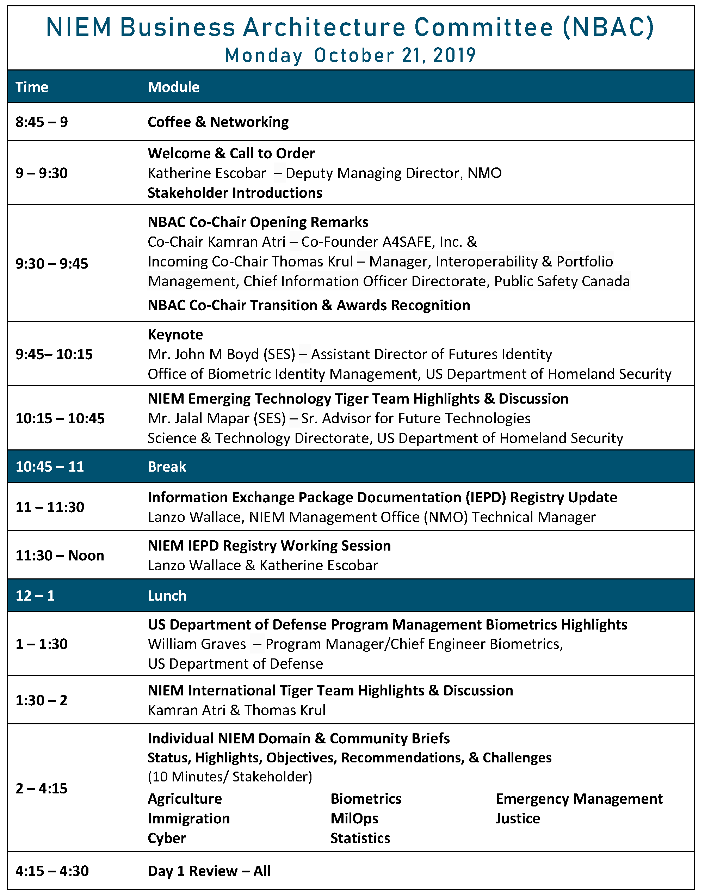

Slide 6
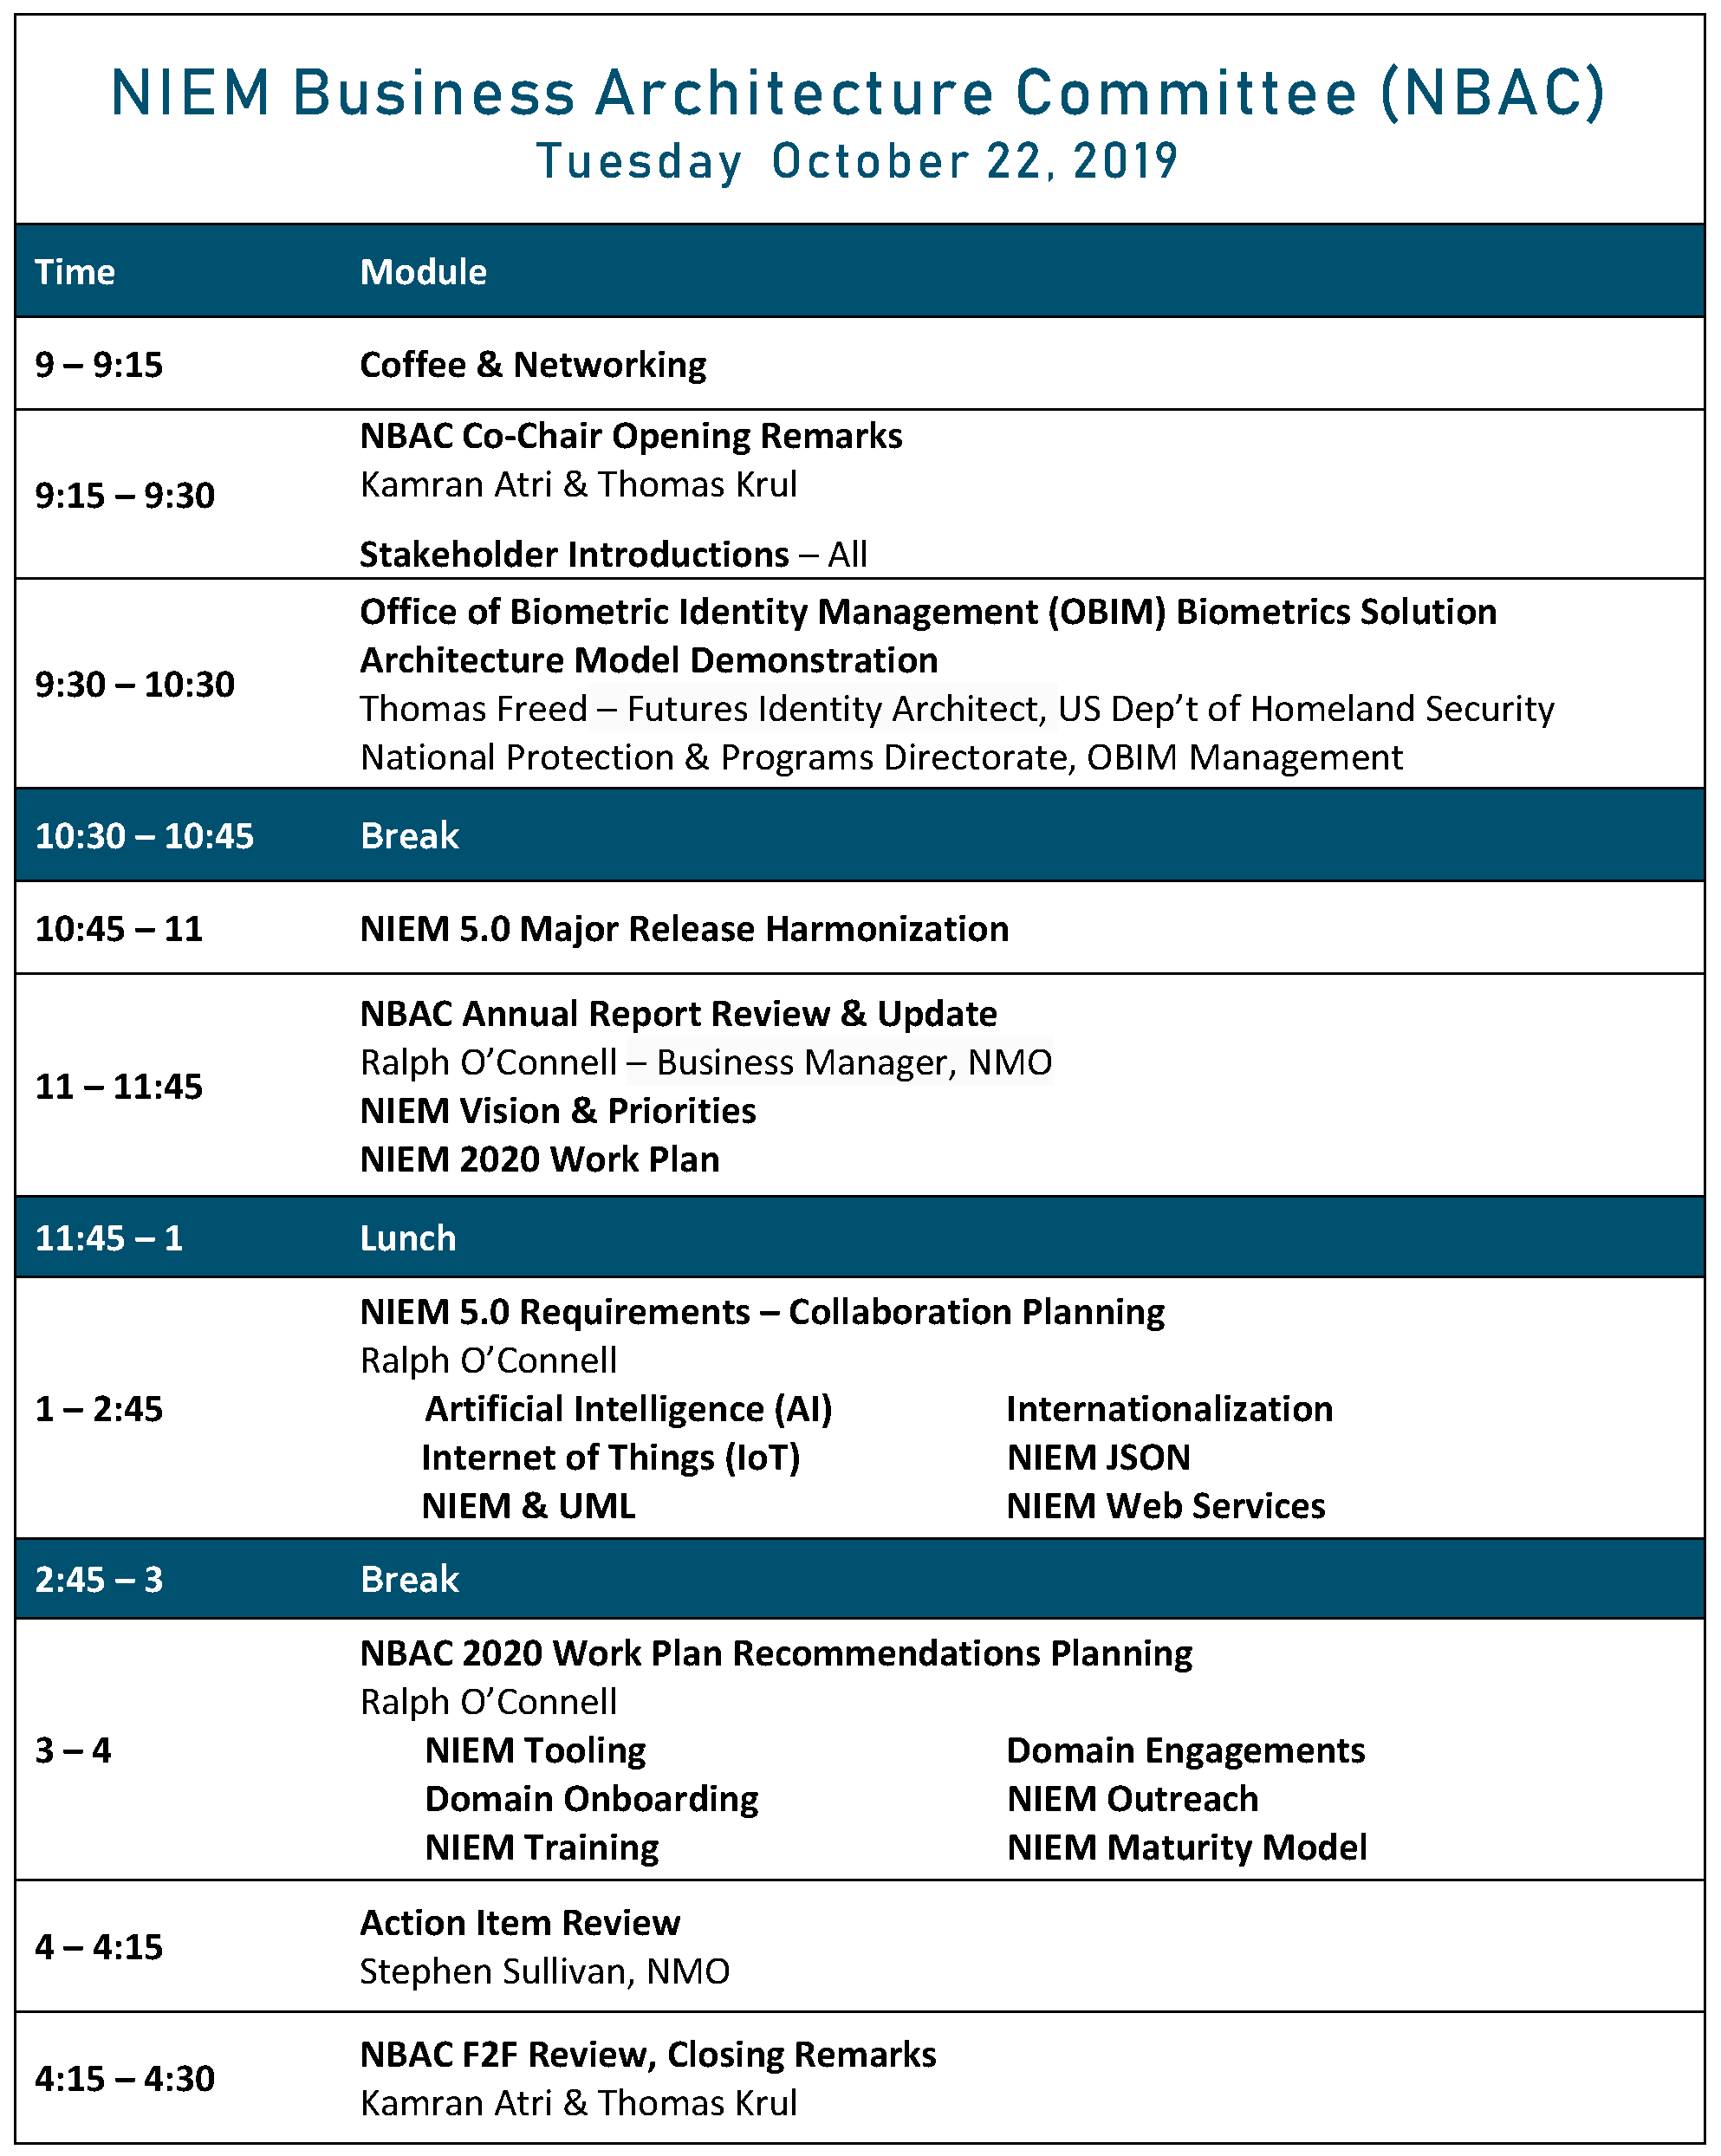

Slide 7
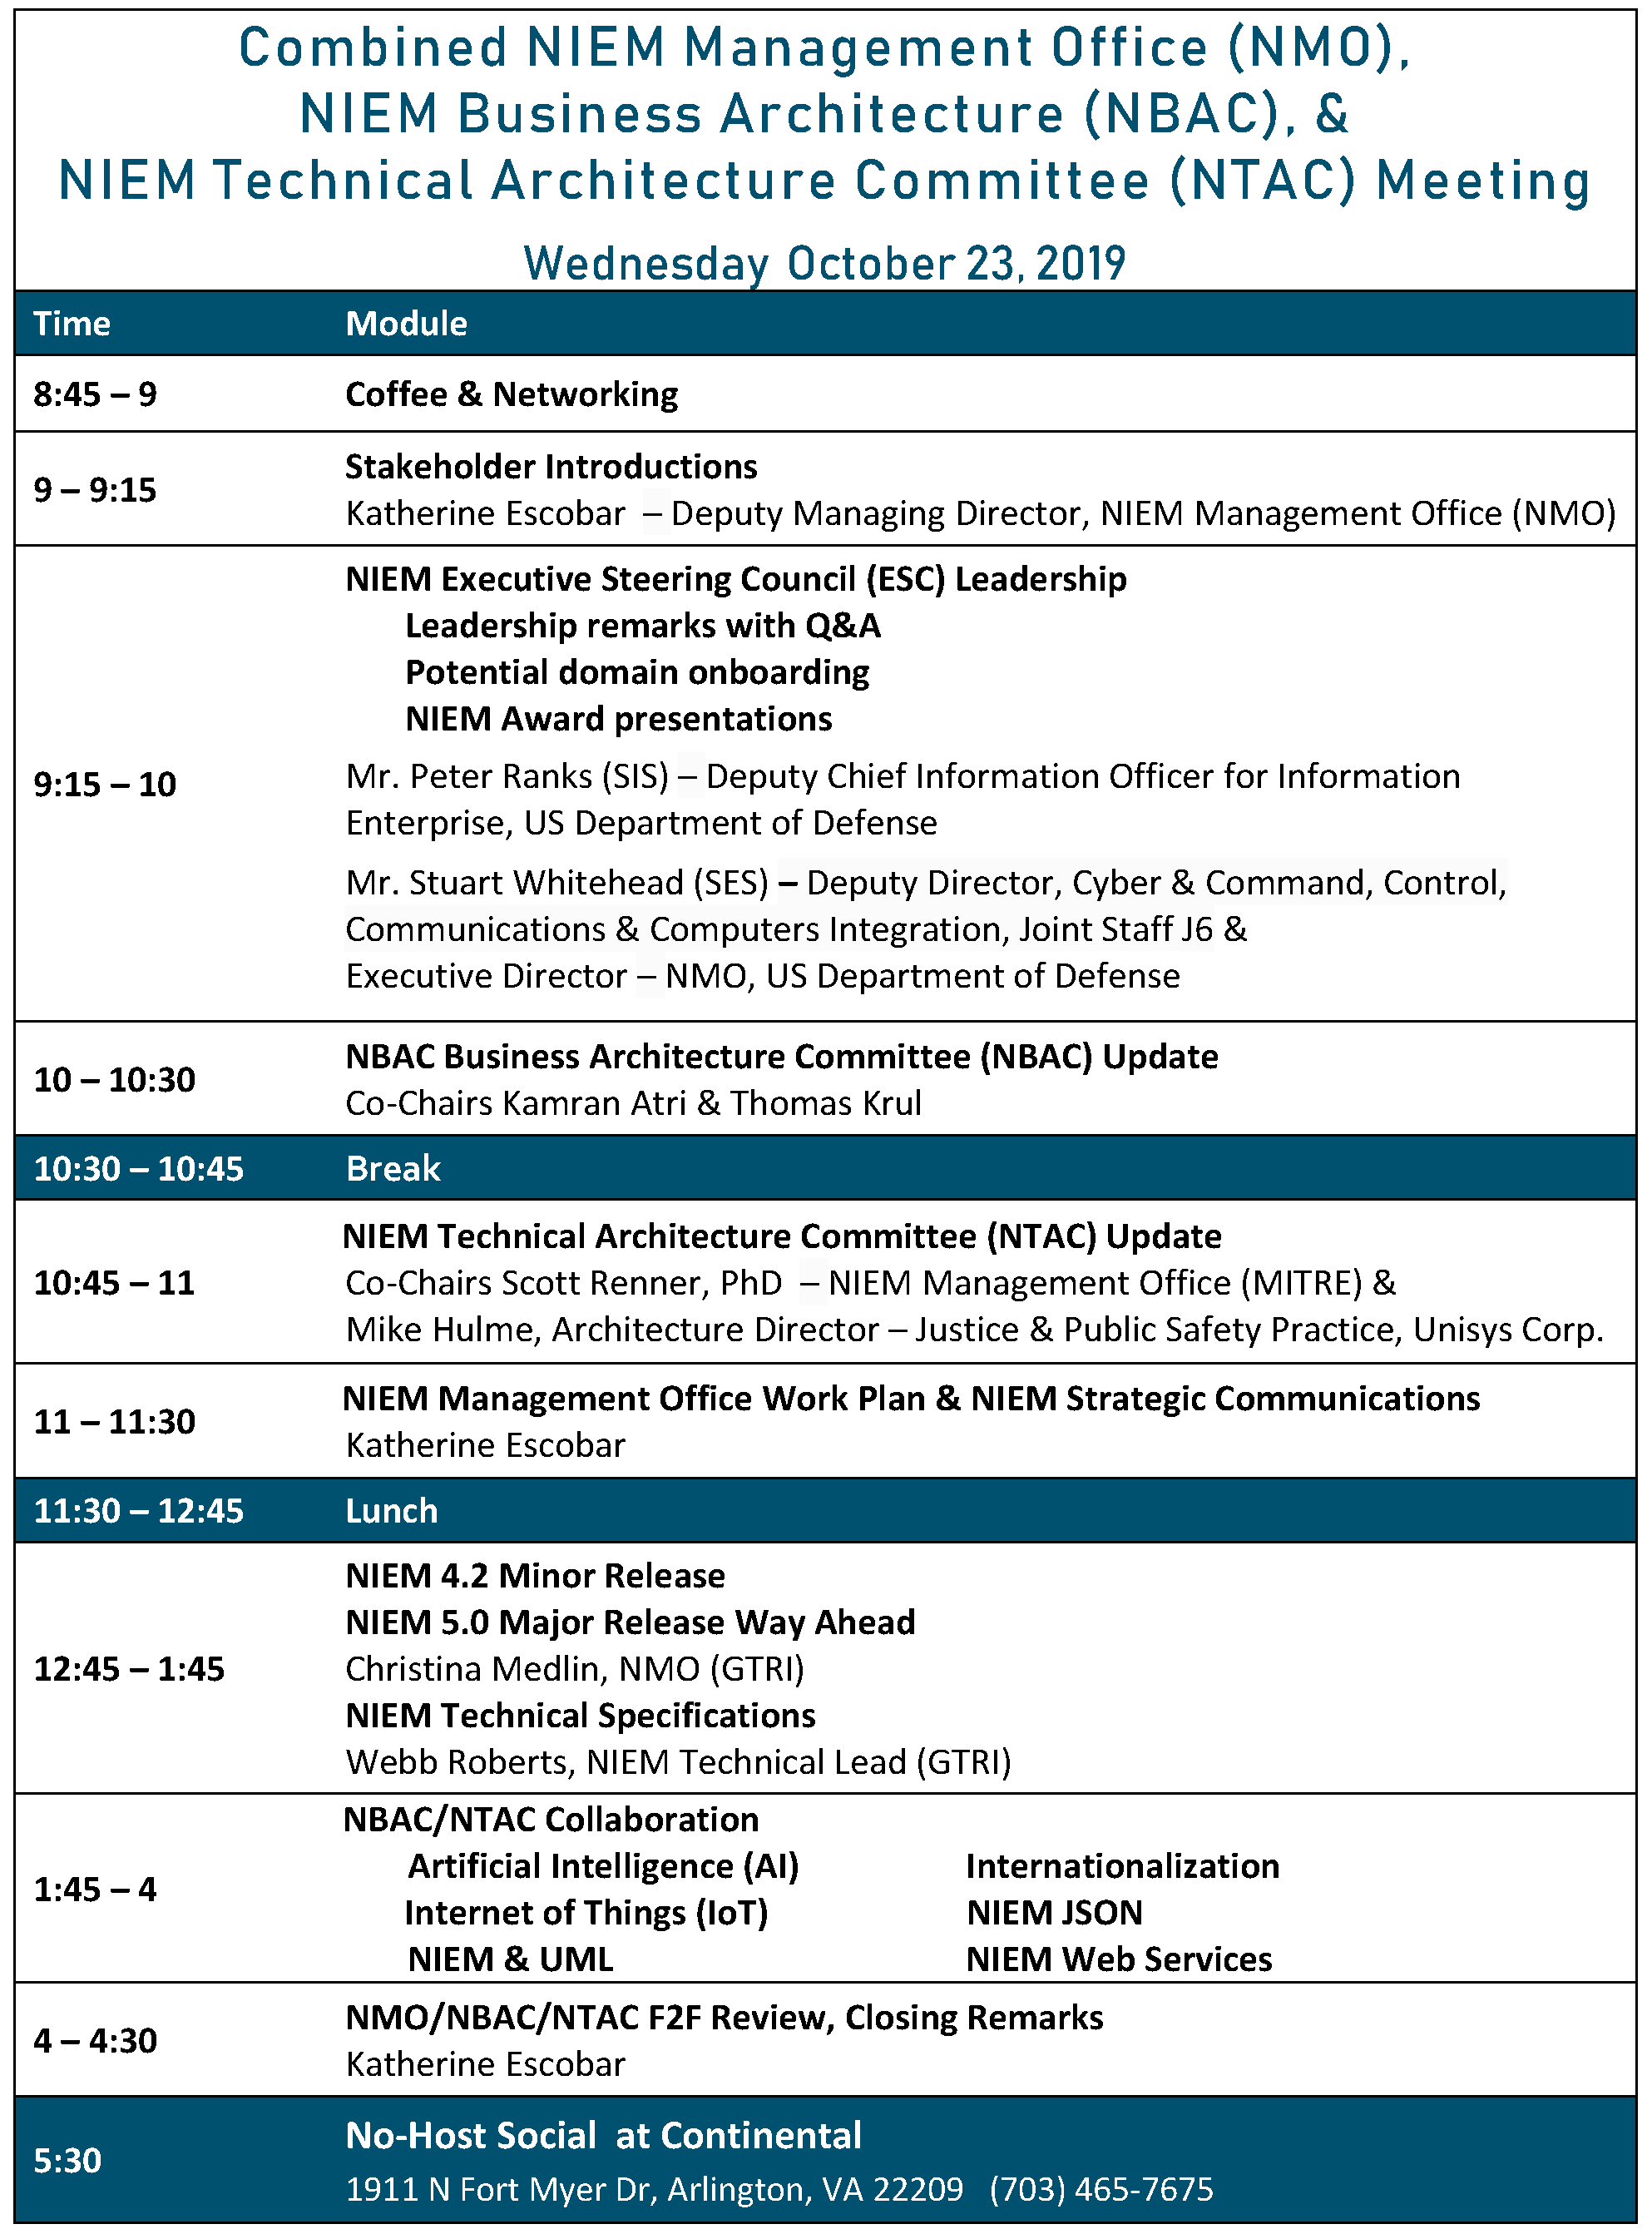

Slide 8

NBAC Co-Chair 2016 - 2019
Thank You Mr. Schultz For Your Services
In Strengthening Our NBAC Community
10/21/2019

Slide 9
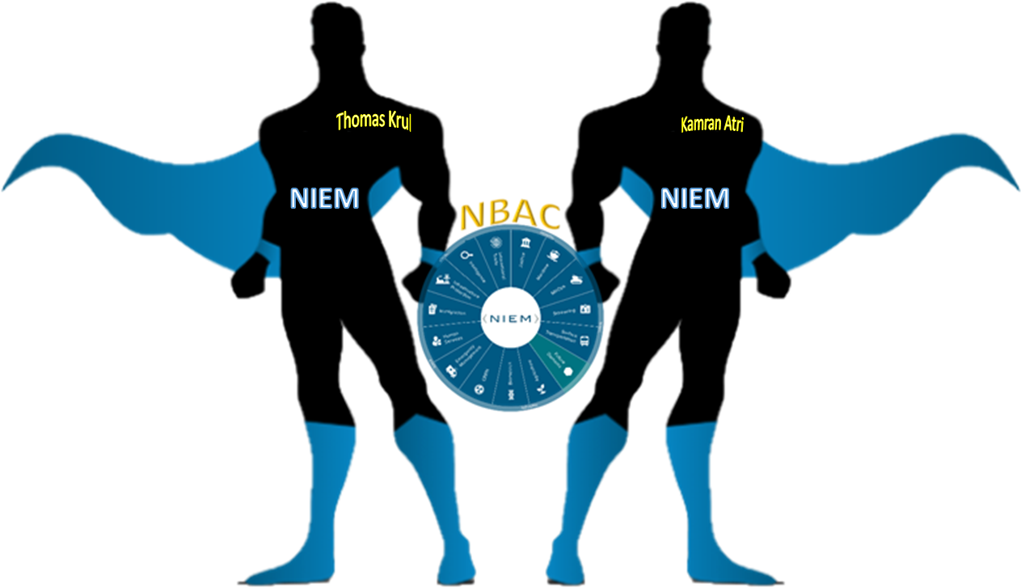
Welcome To 2019 NIEM Face To Face Session
2019 NBAC F2F Meeting
Enabling Connected Future Now
10/21/2019

Slide 10
Reminder
Well-informed decisions will be taken, recorded, and carried out
Your full participation is a must to ensure success
Follow the agenda agreed - with time limits on topics
Hear-to-learn from each other with open mind
Don’t be shy, speak up
Ask questions … share your views
We will abide by decisions which will be collectively decided upon during these meetings
Sometimes its lonely out there - build your network here with fellow data standards guru
Every NBAC member is a direct participant in the NIEM
decision-making process

Slide 11







Presented by:
Kamran Atri , Thomas Krul &
Katherine Escobar
katri@A4SAFE.COM
Thomas.krul@canada.ca
katherine.b.escobar.civ@mail.mil
Co-Chairs of NIEM Business Architecture Committee (NBAC)
NIEM PMO

Slide 12
backup

Slide 14
GROUND RULES
  Work together to
  stay on track
  Make your point
  and move on
  Debate IDEAS,
  not PEOPLE
  Ask questions if you have questions
  Be engaged and acknowledge each others’ contributions
  Share new ideas
  and be innovative!

Slide 15
Welcome
Introductions
Please share
Your name
Agency/affiliation
NIEM relationship/areas of involvement
(e.g., Domain, NBAC, NTAC, ESC, NMO, Emerging Technology Tiger Team, International Tiger Team, etc.)

Slide 18
GROUND RULES
  Work together to
  stay on track
  Make your point
  and move on
  Debate IDEAS,
  not PEOPLE
  Ask questions if you have questions
  Be engaged and acknowledge each others’ contributions
  Share new ideas
  and be innovative!

Slide 19
FACILITIES
Restrooms require a key. Ladies turn left immediately and bathroom on the right. Mens are through the elevator bank and down hall to the left.
Coffee, Water, and Light Snacks available in the back of the room
Please turn Cell phones to silent and take call outside the meeting room
WiFi is available from the Guest network. Enter the password, then open a new Internet Explorer window and accept the terms.
GTRI spaces are secured. If you leave the area, knock on the glass doors to get back in
If you have any problems, call Katherine Escobar
757-434-3291

Slide 20
Welcome
Introductions
Please share
Your name
Agency/affiliation
NIEM relationship/areas of involvement
(e.g., Domain, NBAC, NTAC, ESC, NMO, Emerging Technology Tiger Team, International Tiger Team, etc.)

Slide 22
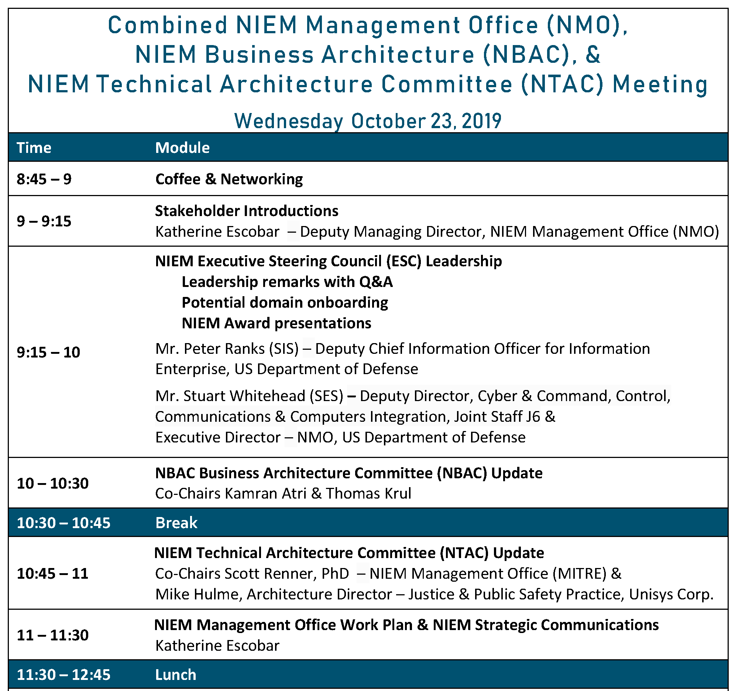

Slide 23
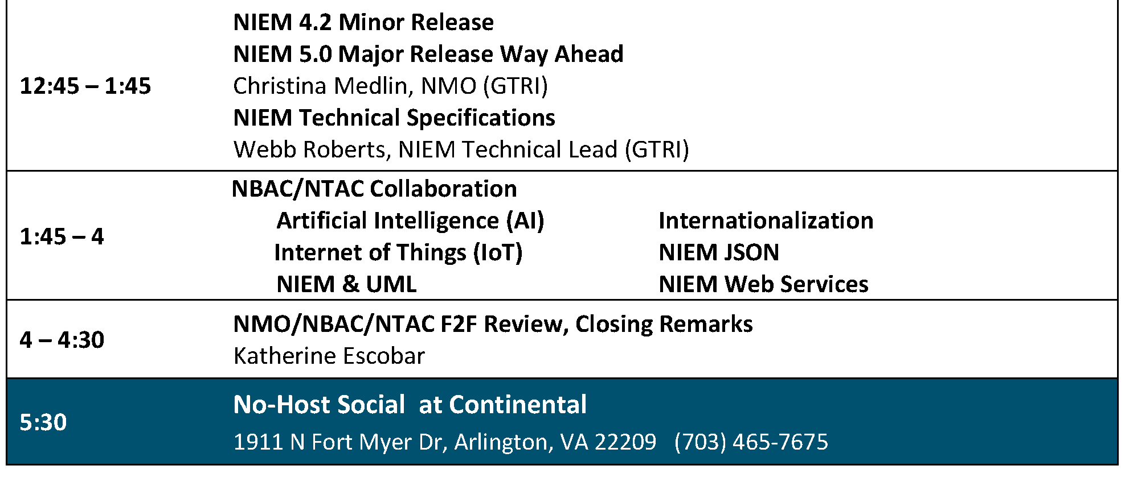

Slide 24
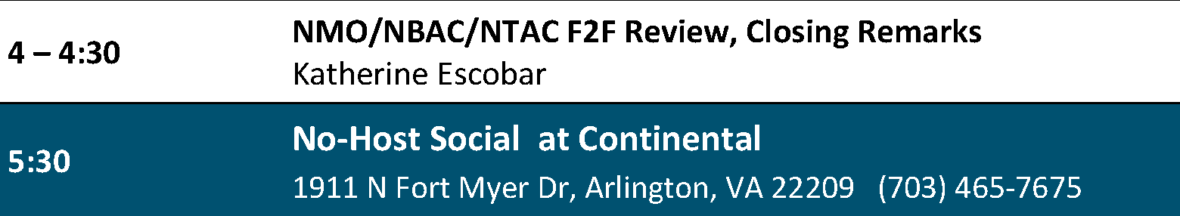

Slide 25
NIEM Executive Steering Council (ESC) Leadership
Mr. Stuart Whitehead (SES)
Deputy Director, Cyber & Command, Control, Communications & Computers Integration, Joint Staff J6 &
Executive Director – NMO, US Department of Defense
Mr. Peter Ranks (SIS)
Deputy Chief Information Officer for Information Enterprise US Department of Defense

Slide 26


Slide 27


Slide 28


Slide 29


Slide 30


Slide 31


Slide 32


Slide 34
Welcome
Introductions
Please share
Your name
Agency/affiliation
NIEM relationship/areas of involvement
(e.g., Domain, NBAC, NTAC, ESC, NMO, Emerging Technology Tiger Team, International Tiger Team, etc.)

Slide 35
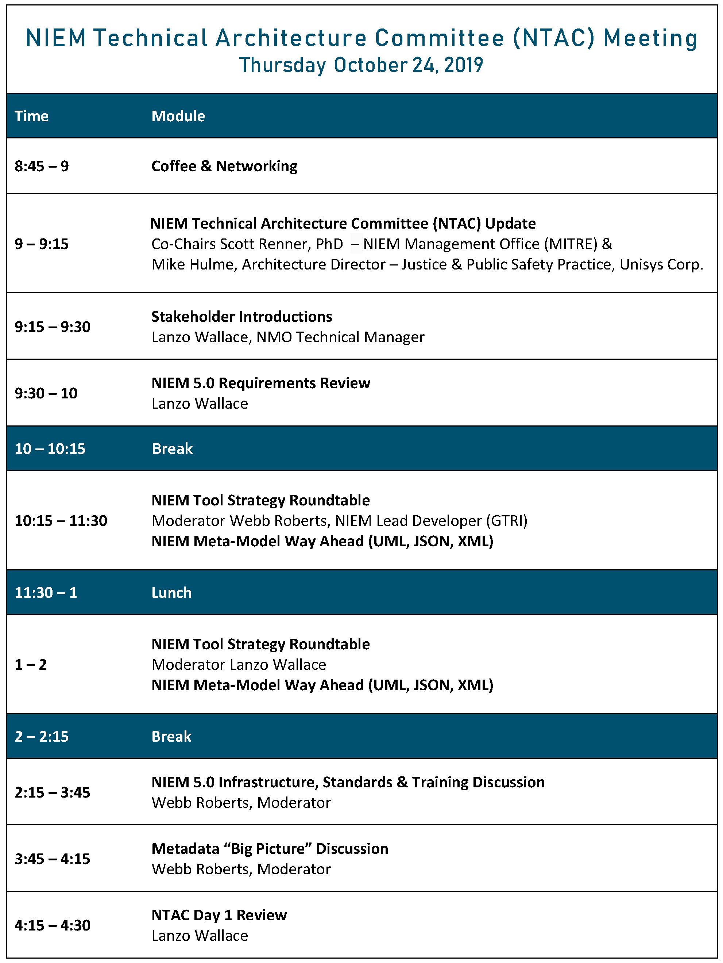

Slide 37
Welcome
Introductions
Please share
Your name
Agency/affiliation
NIEM relationship/areas of involvement
(e.g., Domain, NBAC, NTAC, ESC, NMO, Emerging Technology Tiger Team, International Tiger Team, etc.)

